Slide 1
Introduction to Digital Marketing
Digital Marketing

Slide 2
Marketing Applications
Course Outlines
  Base
    What is Marketing?
    What is digital marketing?
    Power of Digital Marketing

Slide 3
Marketing Applications
Course Outlines
  Mindset Development
    Thinking like a digital Marketer
    Digital Marketing Language
    Managing Products and Clients

Slide 4
Marketing Applications
Course Outlines
  Projects
    How to acquire?
    How to win?
    How to Negotiate?

Slide 5
Marketing Applications
Course Outlines
  Skills (Software's and Platforms)
    Social Media Platform
      Facebook
      LinkedIn
      Instagram
      Twitter
    Blogs

Slide 6
Marketing Applications
Course Outlines
  Skills (Software's and Platforms)
    Digital Display Advertisement
      Search Advertisement
      We will learn how google can be used to do marketing?
    Online Leads
      Sales Generation
      How Posting is done on different groups?

Slide 7
Marketing Applications
Course Outlines
  Advance Skills
    E-Commerce Store
    Digital Marketing Plan
    Native Advertisement
    Email Marketing
    Data Analytics
    SEO
    Facebook Insights
    YouTube Studio

Slide 8
Marketing Applications
Course Outlines
  Advance Skills
    Google AdWords
    Google AdSense
    Bloger.com
    Taboola.com (Native Advertisement)
    MailChimp

Slide 9
Marketing Applications
Course Outlines
  Theory of Digital Marketing

Slide 10
Marketing Applications
What is digital marketing?
  Process of Marketing
    Creating
    Communicating
    Delivering
    Exchanging
    Offering

Slide 11
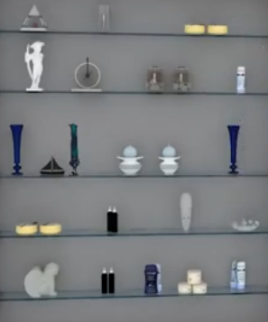
Marketing Applications
What is digital marketing?
  Creating Values
    Certain Process

Slide 12
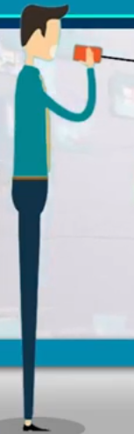
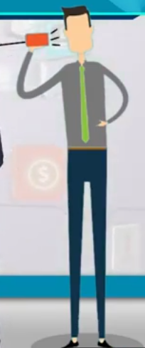
Marketing Applications
What is digital marketing?
  Communicating Values
    Effective Message

Slide 13
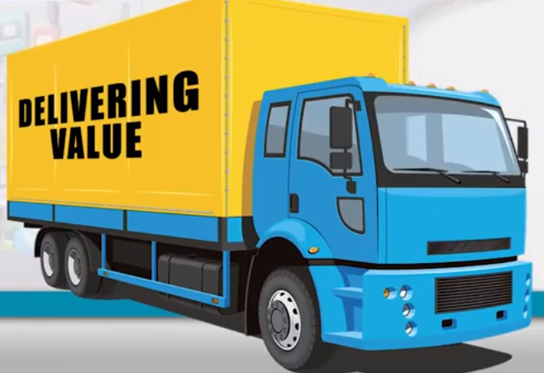
Marketing Applications
What is digital marketing?
  Delivering Values
    Online or Offline

Slide 14
Marketing Applications
What is digital marketing?
  Exchanging Values
    Actual Selling

Slide 15
Marketing Applications
Key Point:
  The purpose of business is not to earn money only.
    Is your customer is satisfy with your product?

Slide 16
Marketing Applications
Evolution of Marketing
  Trade ERA
    Also known as exploration ERA
  Production ERA (1860-1910)
    The focus of marketing was to increase the production Efficiency.
  Sales ERA (1920-1930)
    Need a sales person.

Slide 17
Marketing Applications
Evolution of Marketing
  Brand Development
    Brochures, Pamphlet
  Marketing Company (1960-1990)
    Combine Customer Strategies
  Relationship ERA (1990-200)
    Customer Relationship
  Social media Marketing ERA
    Present ERA

Slide 18
Marketing Applications
What Marketing is providing to Companies?
  Exploring new Avenues
  Optimizing Production
  Creating and Advertising Brands
  Making Company-Wide Efforts
  Creating Customer Relationships
  Involving Communities

Slide 19
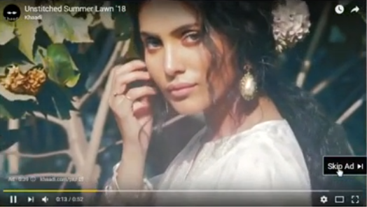
Marketing Applications
What is Digital Media?
  Question 1- YouTube add

Slide 20
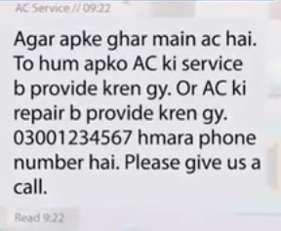
Marketing Applications
What is Digital Media?
  Question 1- AC-Service Messaging

Slide 21
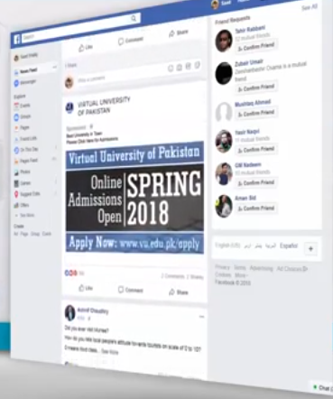
Marketing Applications
What is Digital Media?
  Question 1- Facebook Ad

Slide 22
Marketing Applications
What is Digital Media?
  Digital media refers to audio, video, photo or textual content that has been encoded using a computer and can be transmitted digitally to people.

Slide 23
Marketing Applications
What is Digital Media?
  Features of Digital Media
    Mass Reach
    Interactivity
    Social Networking

Slide 24
Marketing Applications
Digital Media Examples
  Social Media Platforms
    Facebook
    YouTube
    Instagram
    LinkedIn
    Twitter
    Gmail++

Slide 25
Marketing Applications
Digital Media Examples
  Websites
  Blogs
  Email & SMS

Slide 26
Marketing Applications
What is Digital Marketing
  All marketing activities done on modern digital channels.

Slide 27
Marketing Applications
What are those activities?
  Paid Advertisement
  Social Media Marketing
  Email & SMS Marketing
  WhatsApp Marketing
  Mobile Marketing
  Search Engine Optimization
  Marketing Research

